Slide 1

Customer Churn Prediction for Telecommunication Company
Enabling Targeted Retention Offers using Machine Learning

Slide 2






TEAM MEMBERS OF GROUP 9
SHREYAS DAS
SOUMYA RATH
SOUMYA S. MOHARANA
SWAYAM PRAKASH SAHU
SUBRAT SAMAL
BIBHUPADA PANDA

Slide 3
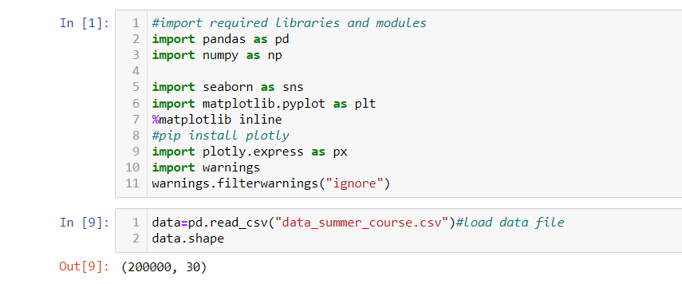
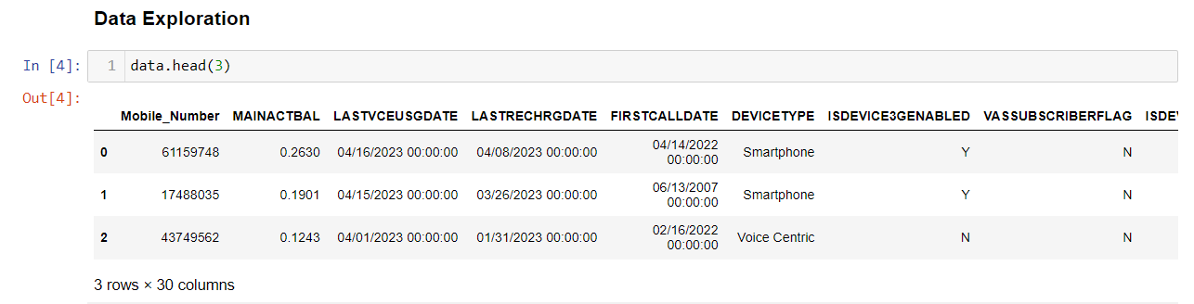
DATA EXPLORATION

Slide 4
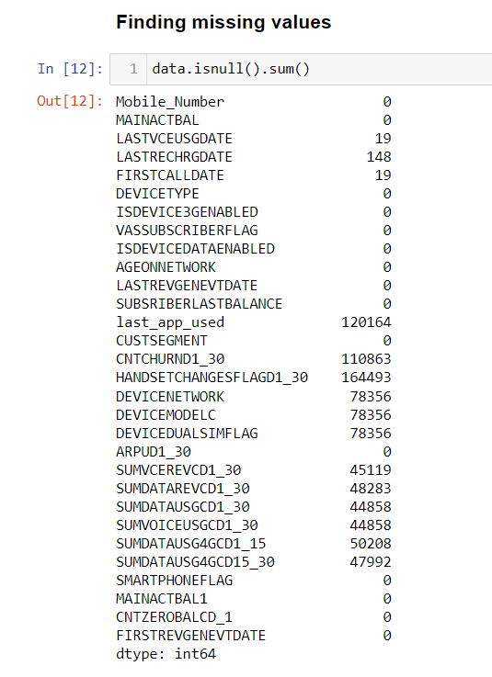
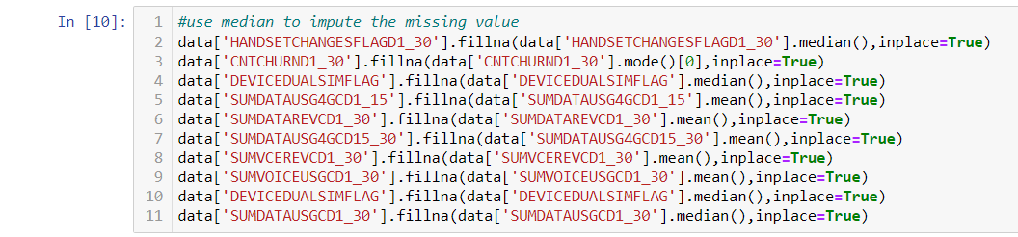
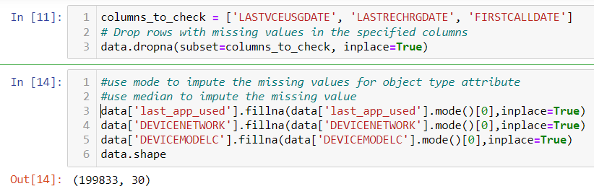
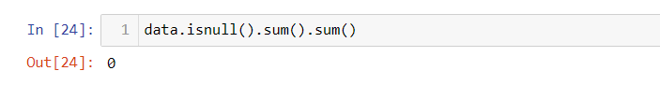
DATA TRANSFORMATION

Slide 5
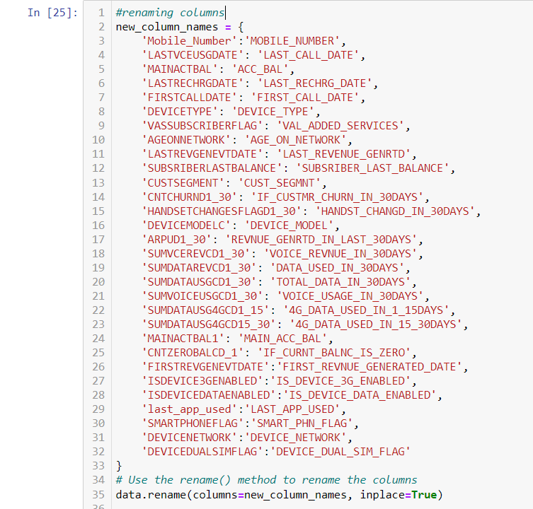
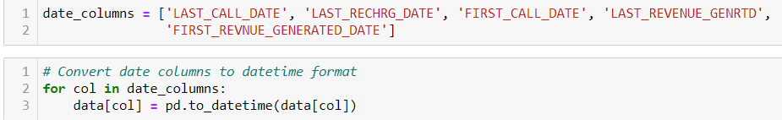
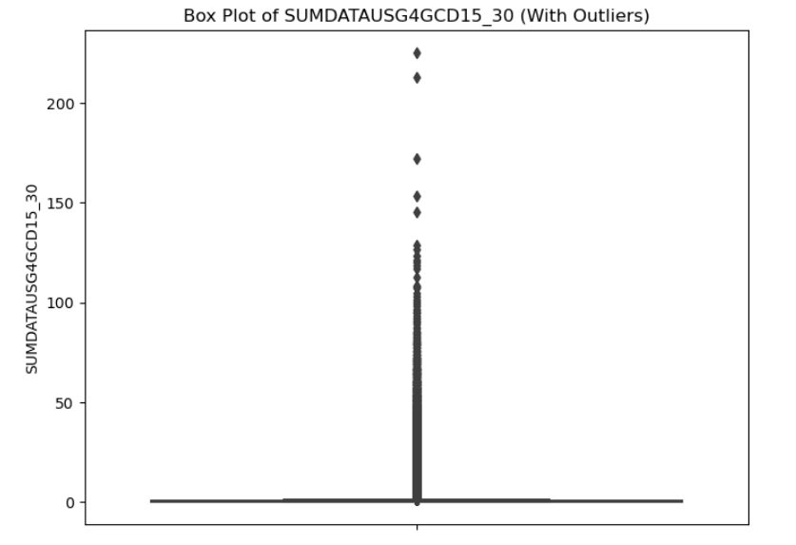

Slide 6
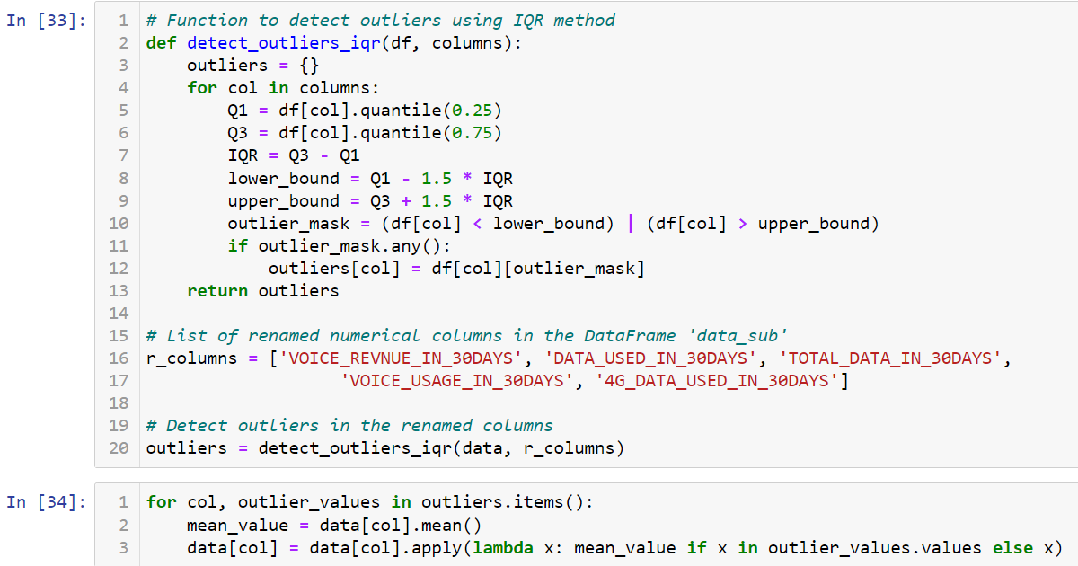

Slide 7
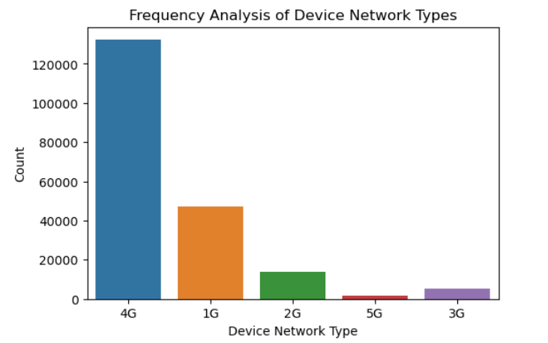
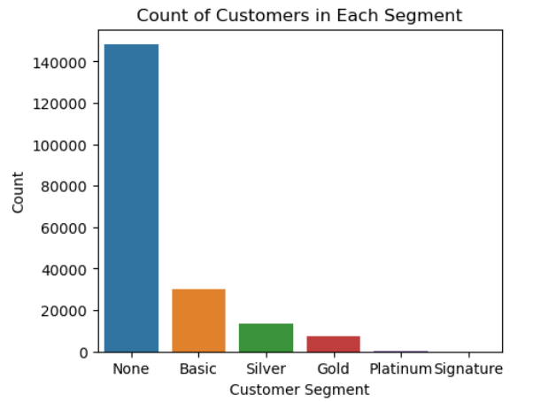
DATA VISUALIZATION

Slide 8
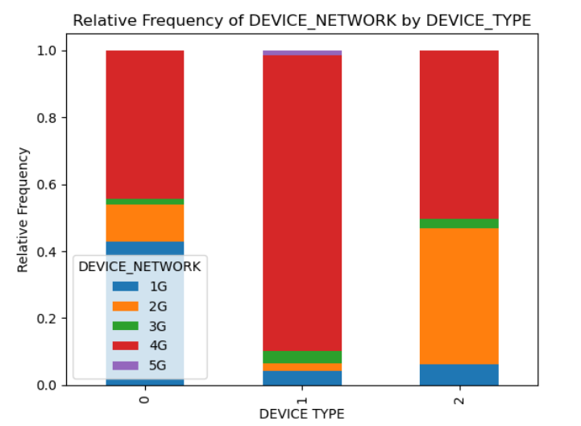
INFERENCE
Customer Segment Analysis:
The majority of customers fall into the 'None' segment, followed by Basic, Silver, Gold and Platinum.
Revenue Generation Analysis:
The revenue generated in the last 30 days is negatively skewed, with lower concentration towards higher values.
Device Type Analysis:
The majority of customers use Voice centric ,Smartphones, followed by Feature Phones.
Device Network:
The majority of customers use 4G, 1G, 2G, 3G and 5G. We conclude maximum users use 4G and people are starting to use 5G.
Customer Churn Analysis:
Taking 1 to 7 as the probability of people who are going to discontinue their services, 1 as the least and 8 as the highest,
we conclude most of the people are not going to discontinue the service.
Observations:
Customer churn is relatively low, suggesting that the company is retaining most of its customers.
Overall, the data analysis revealed valuable insights about customer segments, revenue generation, device usage, and customer churn. These findings can be used to make data-driven business decisions and formulate strategies for customer retention and revenue growth. Data cleaning and transformation were crucial steps in ensuring data quality and reliable analysis.
Multivariate analysis

Slide 9
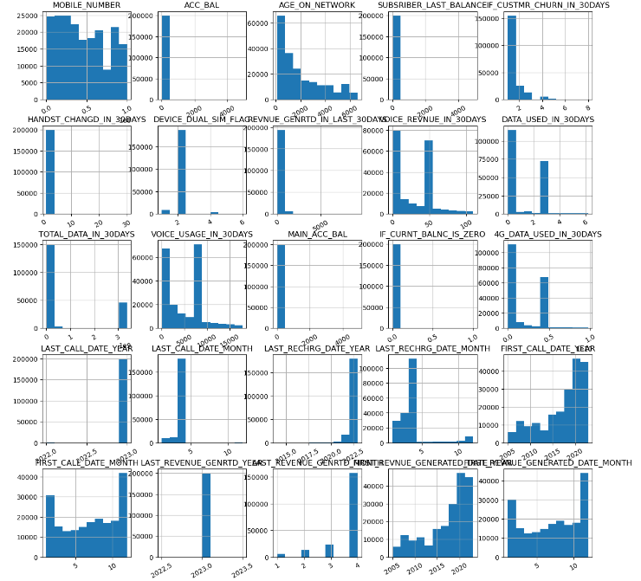

Slide 10
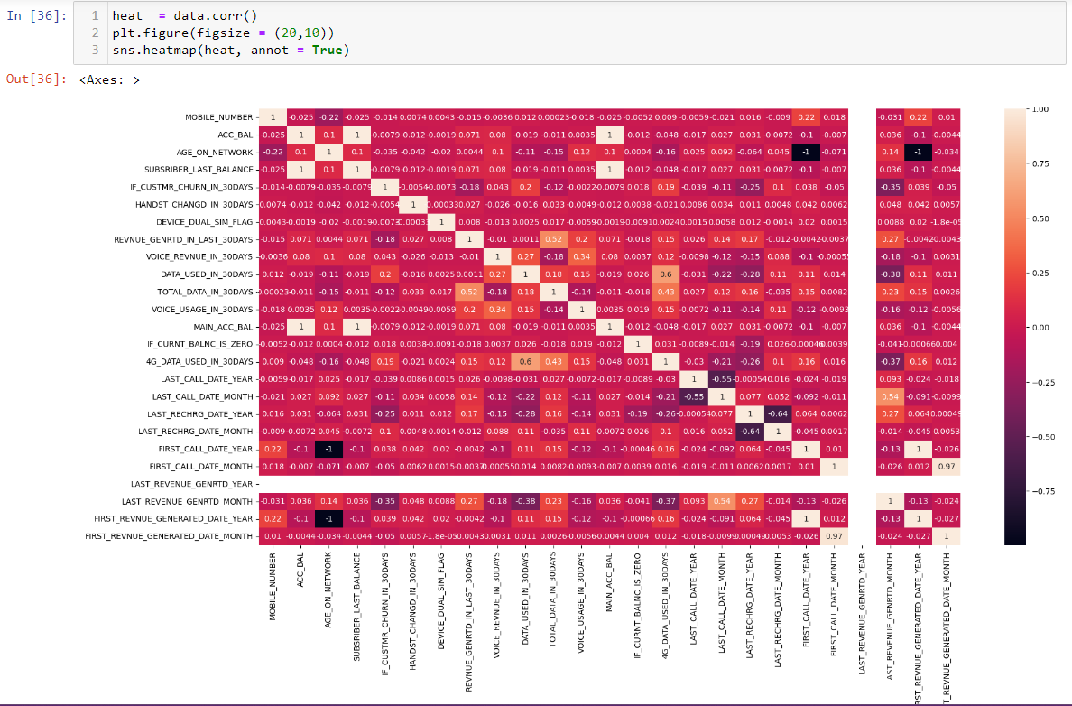

Slide 11
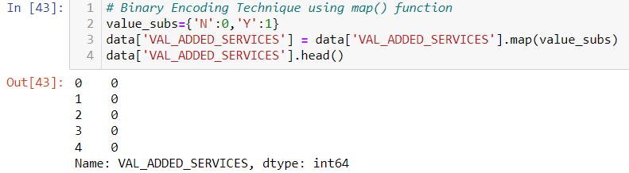
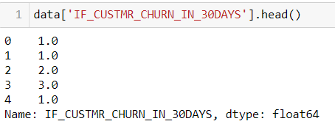
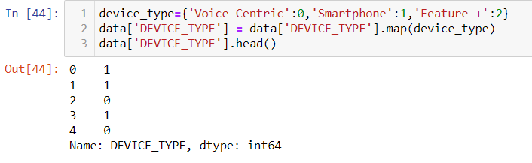
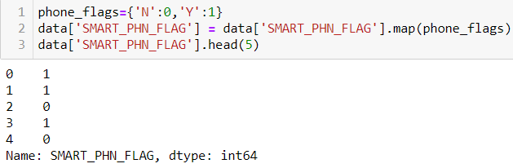
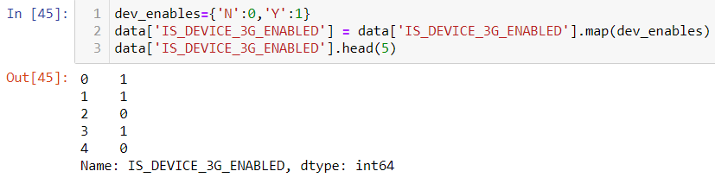
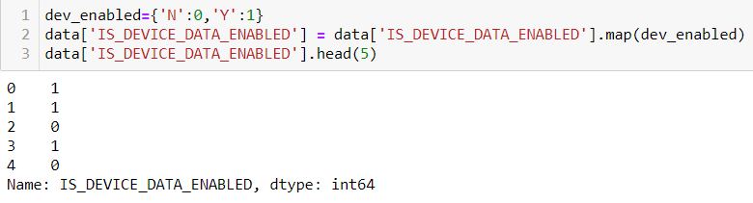
BINARY ENCODING

Slide 12
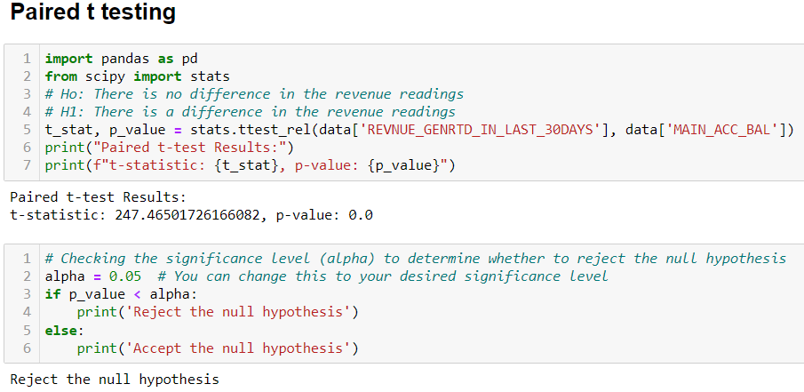
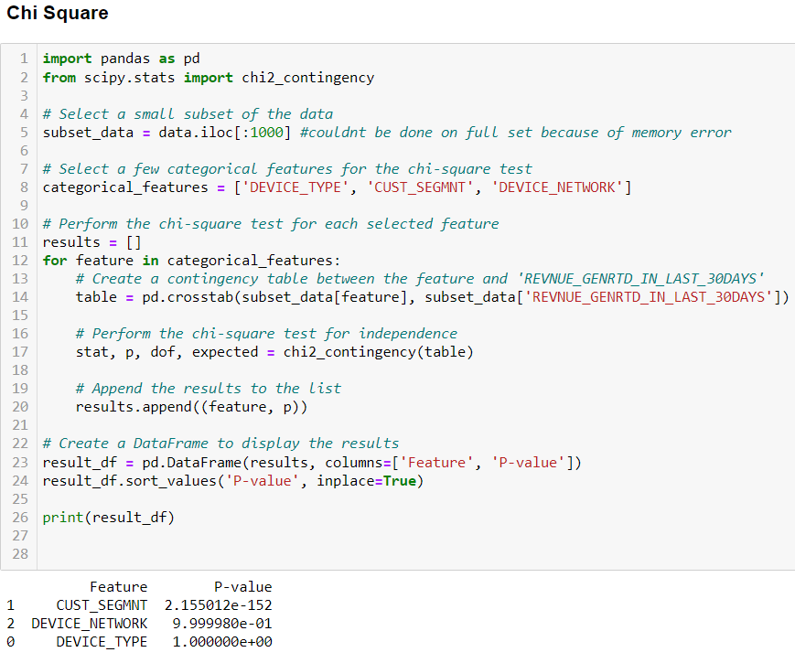
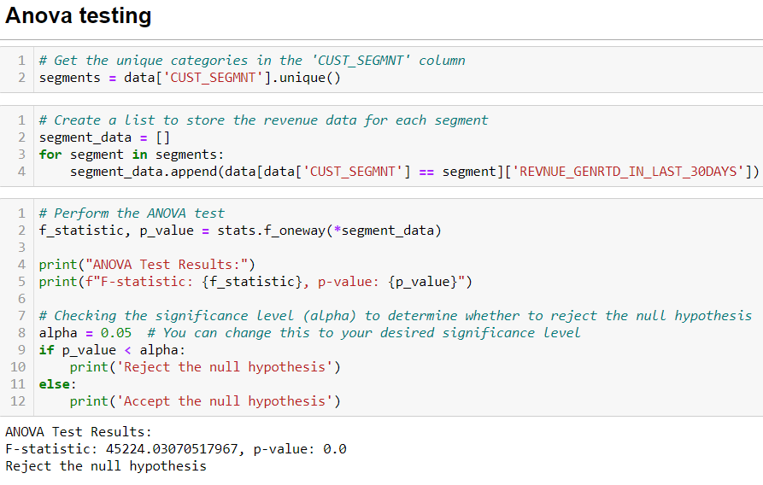
HYPOTHESIS TESTING

Slide 13
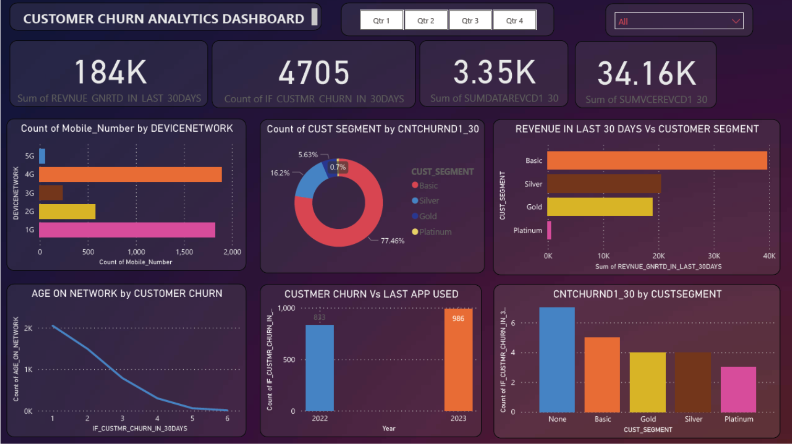
POWER BI VISUALIZATION
Emphasis should be placed on nurturing customers in the Basic segment, as they represent a significant 77% of the entire customer base at risk of churning within the next 30 days.
The aggregate data revenue collected over the past month is not satisfactory, the implementation of more alluring plans and schemes becomes imperative to increase revenue growth.
Offer personalized recommendations to distinct customer segments, catering to the specific needs and preferences of each targeted consumer.
Examine how well the retention offers work in reducing customer loss, and evaluate their impact on keeping customers loyal and engaged.

Slide 14
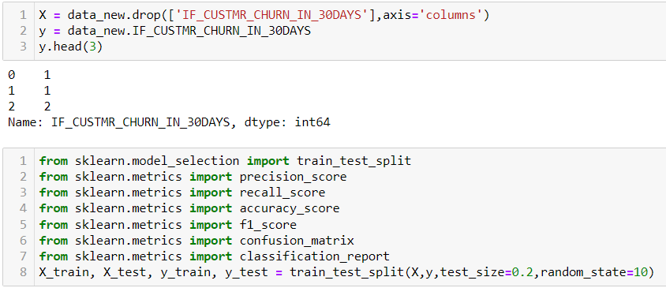
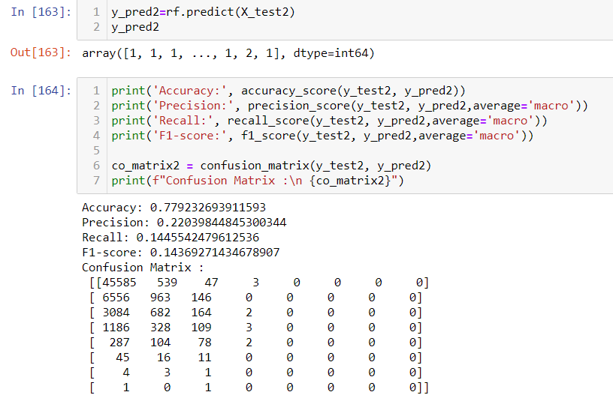
MODEL BUILDING
Random Forest Classifier

Slide 15
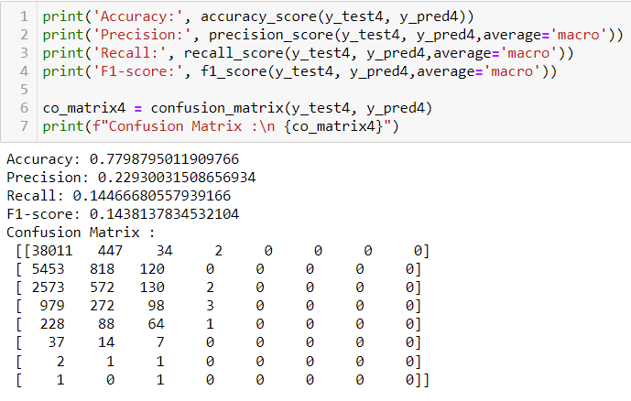
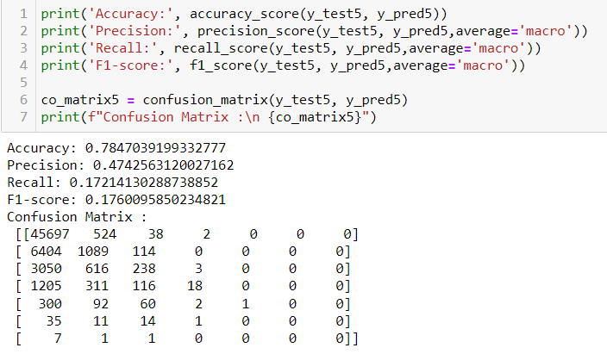
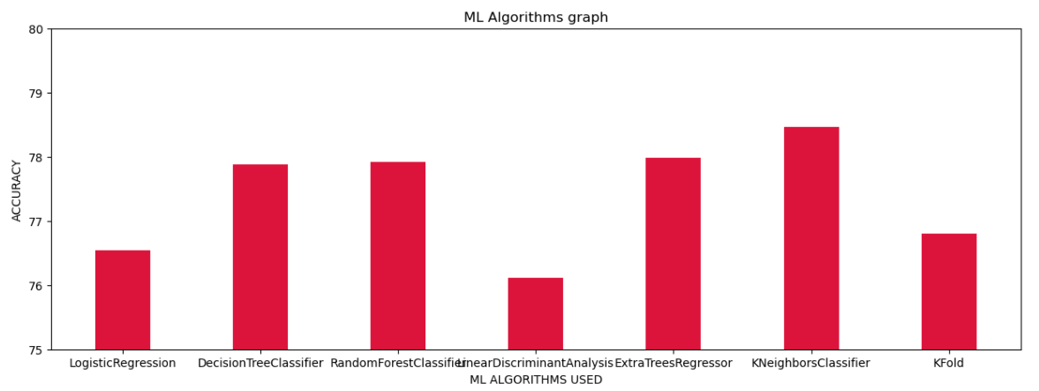
Extra Tree Regressor
K Nearest Classifier
Bar Graph demonstrating the accuracy of various models

Slide 16
THANK YOU

